Slide 1
Global and Regional Modelling Experiments
Regional Modelling Results from HTAP2
and Questions for HTAP3
Terry J Keating, PhD

Slide 2
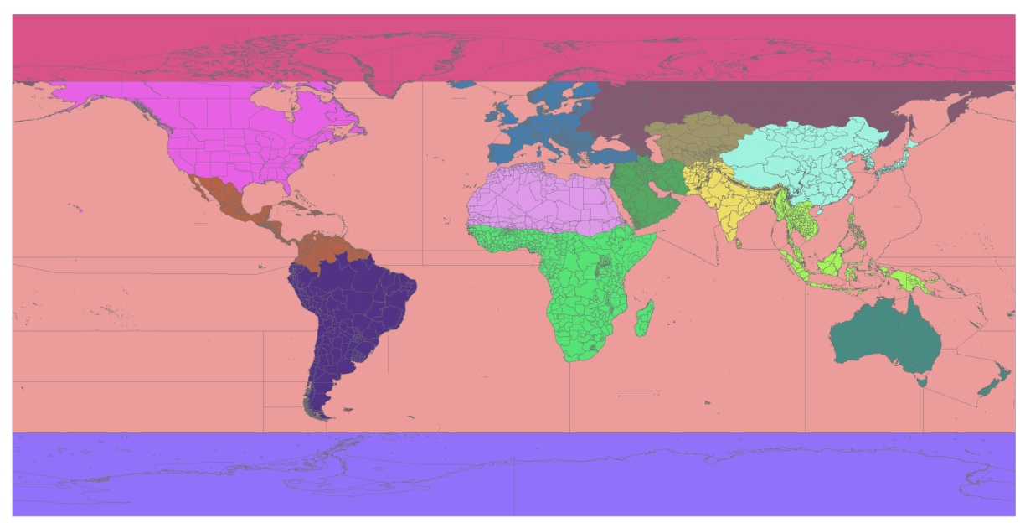
HTAP2: Coordinated Global and Regional Modelling Experiments
Overall HTAP2 Approach:
1) Use global and regional simulations of 2008-2010 to
  a) evaluate against observations
  b) contribute to the quantification of parameterized S/R relationships.
2) Use these parameterized S/R relationships to estimate impacts of future strategies.
World divided into 16 Regions (60 sub-regions):
  Priority source regions: North America, Europe, East Asia, South Asia, Russia and Eastern Europe, Middle East
Nested Regional Simulations
AQMEII (Phase 3): Europe and North America
MICS-Asia (Phase 3): Asia and East Asia
AQMEII
AQMEII
MICS
Asia

Slide 3
HTAP2: Coordinated Global and Regional Modelling Experiments
Questions For Regional Modelling in HTAP2:
How does model performance compare between global and regional models?
How does response to extra-regional emission changes compare between global and regional models?
What drives the differences in sensitivity to extra-regional emission changes?
What are the implications of regional vs. global modelling for benefits assessment?

Slide 4
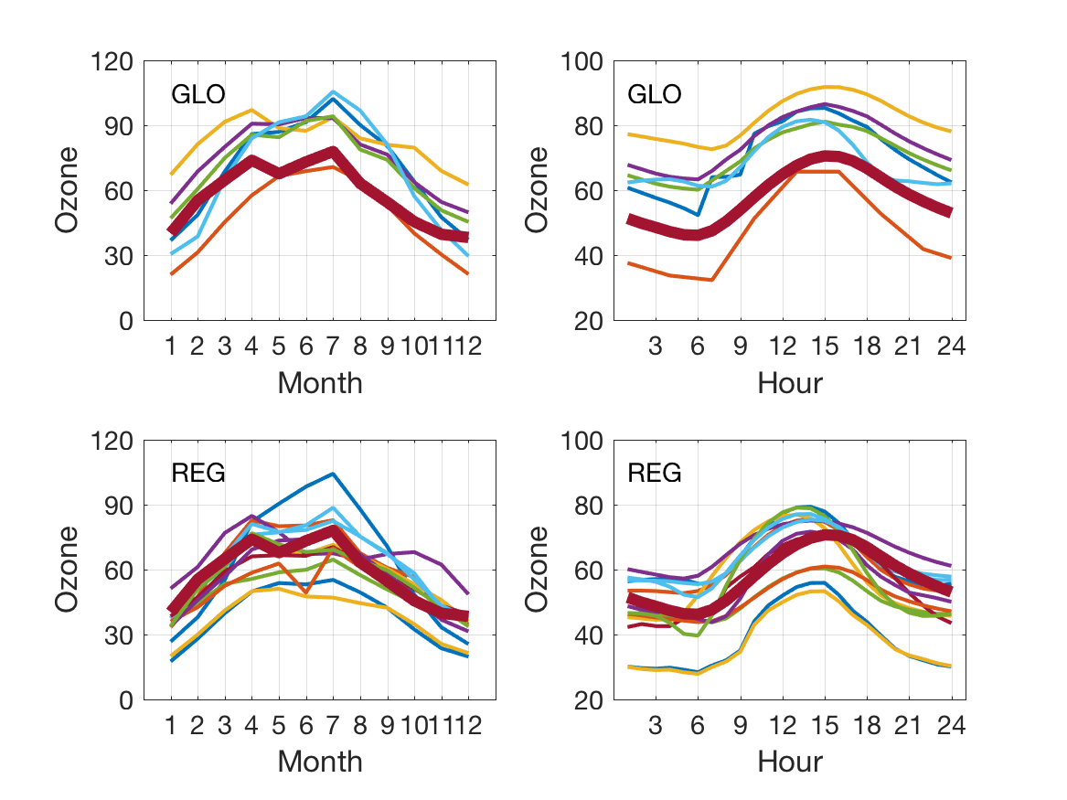
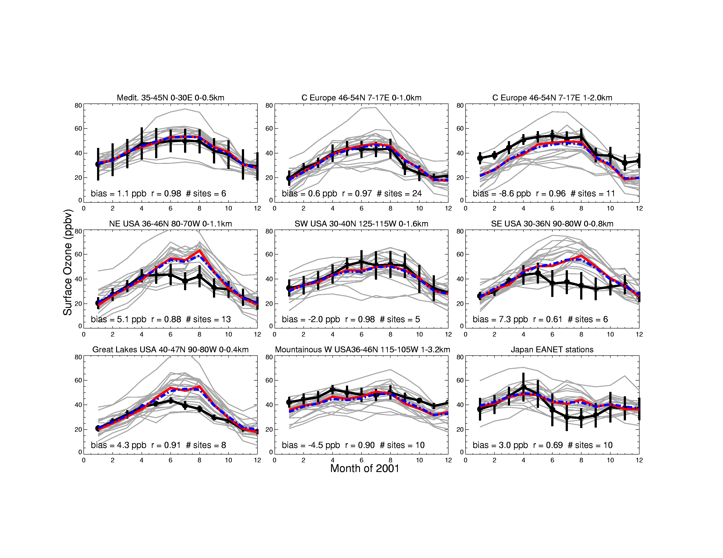
Model evaluation
Regional and global models were systematically compared for O₃ and PM_{2.5} in the US, and North America, using the ENSEMBLES system at JRC and AEROCOM/EBAS at Met.No
HTAP2
Mediterranean
C Europe <1km
HTAP1 Results
AQMEII3
C Europe >1km
Similar model spread in Europe between HTAP2 global and AQMEII3 regional models
The best performing global models behave similarly to well-performing regional models.
Ensemble of AQMEII3 regional models was overall less biased than the HTAP2 global models.
HTAP2 global models seemed to be somewhat more biased than the HTAP1 global models.
The biases are most important for threshold-based metrics like AOT40
Source: Galmarini (2018)

Slide 5
Characterization of model errors
In AQMEII3 and HTAP2 several novel methods were proposed for understanding sources of errors:
Decomposition of time series
Tracers of boundary conditions
Tracers of longer-lived components
Emission error propagation
Global
Regional
Error
Global models have a larger long-term error component – pointing to issues in emissions/chemistry and transport/inflow processes.
It is hard to pinpoint errors in long-range transport models with available observations.
In global air quality modeling, there is no preferred method yet for model evaluation and error characterization. Methods need to be shared across communities.

Slide 6
Boundary Condition Tracers
All AQMEII3 modeling groups were asked to include three non-reactive tracers in their simulations.
These tracers are designed to track the inflow of ozone from the lateral domain boundaries. The tracers should be specified as lateral boundary conditions, with no emissions or chemical formation/destruction occurring for these tracers within the modeling domain. The tracers are defined as follows:
  O3_BC1: For layers below 750 mb (~2.5 km), set this tracer to the same concentration as the O₃ boundary conditions. For layers above 750 mb, set the tracer concentration to zero.
  O3_BC2: For layers between 750 mb (~2.5 km) and 250 mb (~10 km) , set this tracer to the same concentration as the O₃ boundary conditions. For layers below 750 mb and above 250 mb, set the tracer concentration to zero.
  O3_BC3: For layers above 250 mb (~10 km), set this tracer to the same concentration as the as the O₃ boundary conditions. For layers below 250 mb, set the tracer concentration to zero.
All of these tracers should undergo advection, diffusion, cloud mixing/transport, scavenging, and deposition but no chemistry.

Slide 7
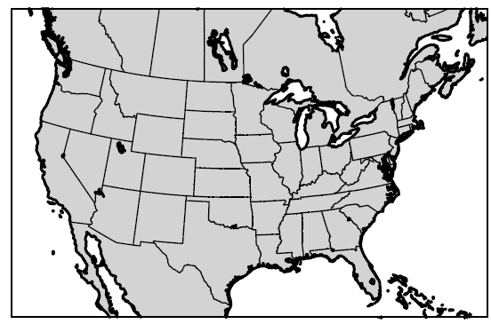
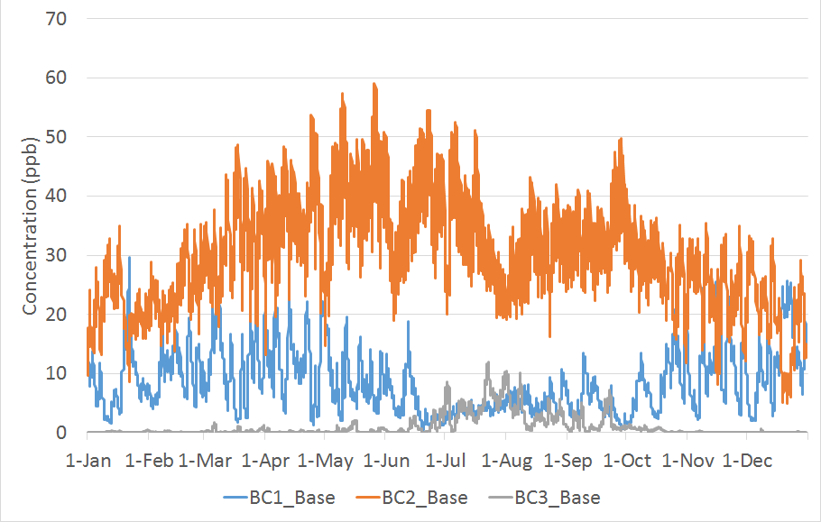
Boundary Condition Tracers
CMAQ AQMEII3 Base Case Tracer Analysis
Hourly Time Series of O3_BC1, O3_BC2, and O3_BC3 Tracers Spatial Average over the Four Corners Region
The contributions show seasonal as well as synoptic fluctuations
The largest contribution is from O3_BC2, i.e. O₃ boundary conditions between 750mb and 250 mb

Slide 8
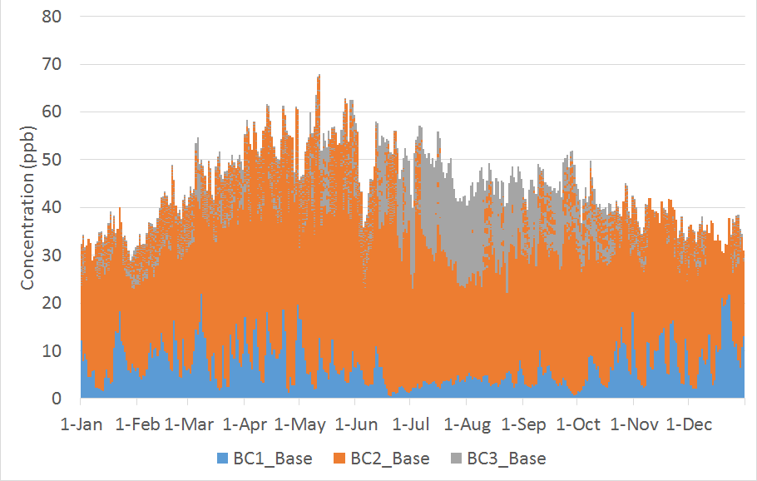
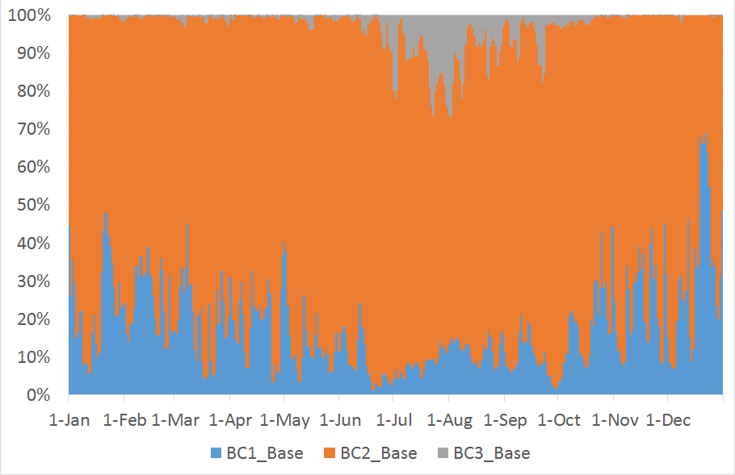
Boundary Condition Tracers
CMAQ AQMEII3 Base Case Tracer Analysis
Same Time Series as on the previous slide,
but presented as Stacked Absolute (left) and Stacked Normalized (right) Bar Chart
The sum of the three non-reactive O₃ boundary tracers peaks in spring
The O3_BC3 tracer (O₃ BC above 250 mb) can reach 10-20% of the total “background” O₃ during summer (if we define background as the sum of the three non-reactive O₃ boundary tracers)

Slide 9
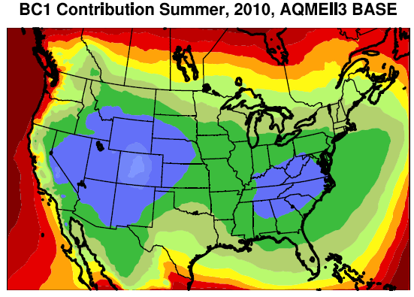
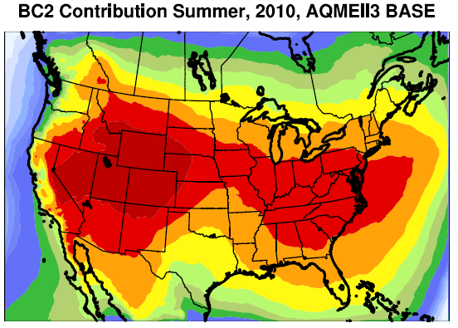
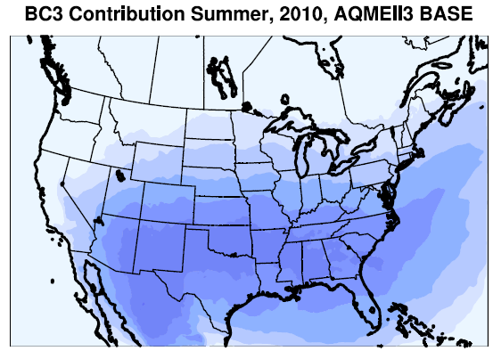

Boundary Condition Tracers
CMAQ AQMEII3 Base Case Tracer Analysis
Normalized Contributions of O3_BC1, O3_BC2, and O3_BC3 to Total “Background”
June – August Average
%
The contributions spatial variations:
  O3_BC1 largest near the boundaries (layers below 750 mb or ~2.5km)
  O3_BC2 largest within the domain, especially over elevated terrain (layers between 750-250 mb or ~2.5-10 km)
  O3_BC3 largest in the southern portion of the modeling domain (layers above 250 mb or ~10km)

Slide 10
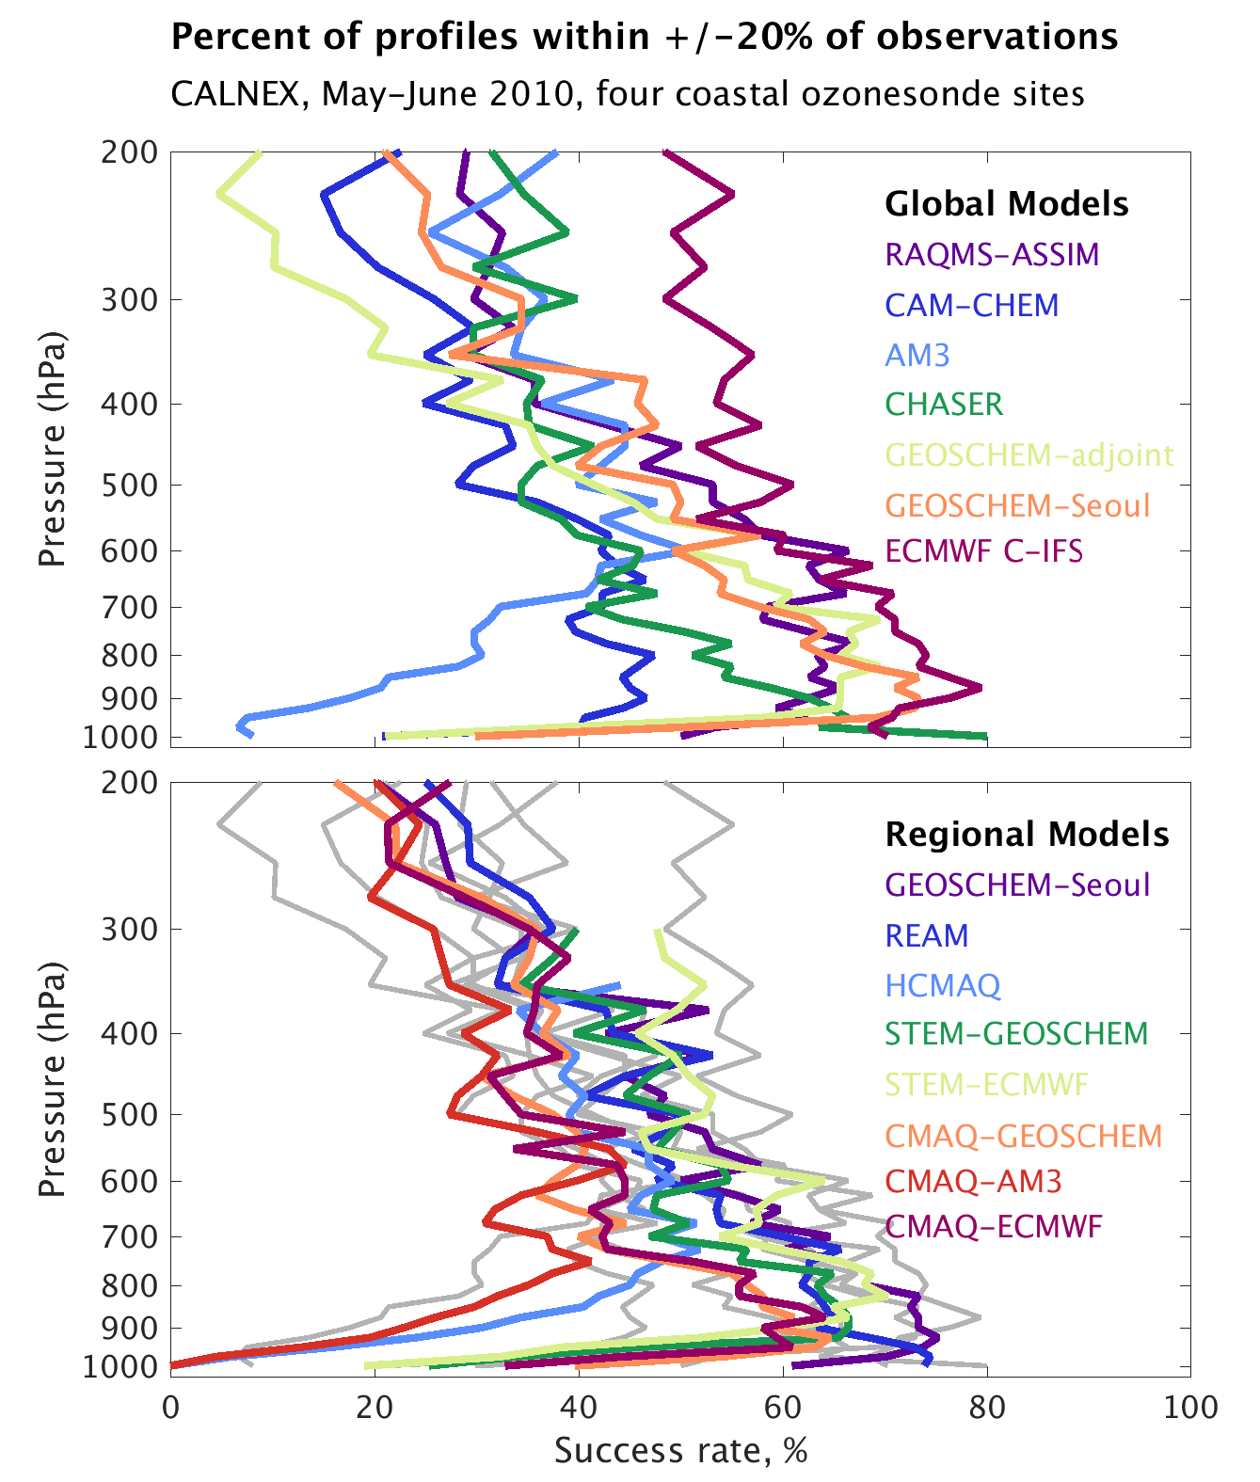
Estimating O₃ Aloft Continues to be a Challenge
Drivers of Model Errors
Success Rate = the frequency that a model is within +/- 20% of the co-sampled observations.
Gray lines in the lower panel indicate the global model values for comparison.
Regional models are within the range of the global models.
Improving process representations is limited by a lack of observations.

Slide 11
Sensitivity to Emissions Changes
Response to Extra Regional Emissions Reductions
  RERER is a metric of the relative sensitivity of concentrations within a region to changes in emissions sources outside the region. It allows us to compare across regions, pollutants, and models.
      RERER = 0, concentrations are sensitive to emissions within the region
      RERER = 1, concentrations are sensitive to emissions outside the region
Annual Average Concentrations |  | O₃ | PM_{2.5}
North America | Regional Models | 0.77 (0.54-0.93) | 0.12 (0.11-0.12)
 | Global Models | 0.34 (pop weighted) | 0.10
Europe | Regional Models | 0.81 (0.44-0.92) | 0.23 (0.01-0.34)
 | Global Models | 0.89 (0.71-1.59) | 0.22 (pop weighted)
RERER for O₃ > RERER for PM → O₃ is more sensitive to extra-regional emission sources than PM
Range of RERER for O₃ is larger than for PM for both regional and global models.
For Europe, regional and global models produce a similar RERER.
For North America, the RERER available from one global model is much lower than for the regional models.

Slide 12
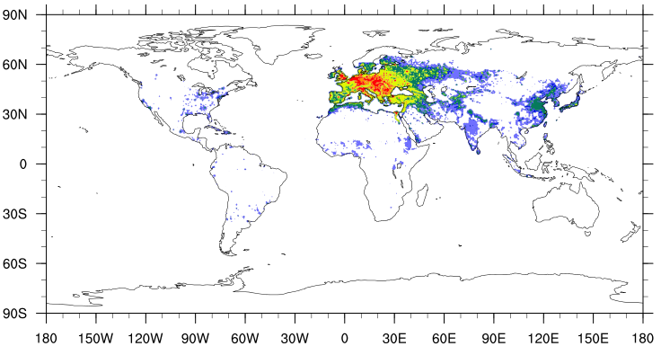
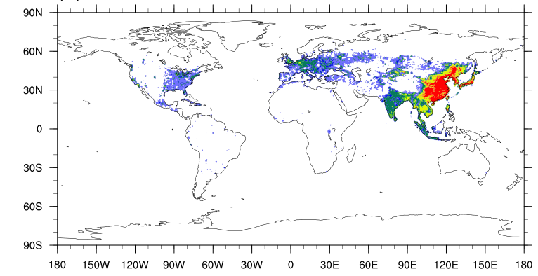
Implications for Benefits Assessment
Avoided PM_{2.5} premature deaths by 20 % regional emission reductions
Avoided PM2.5 deaths/yr/1000 km²
HTAP Estimated PM_{2.5}-related mortality worldwide 2.8 million annually
  Reducing global emissions by 20 % saves 290,000 deaths, 40 % in East and South Asia.
  42,000 deaths by inter-regional atmospheric transport of PM_{2.5}- this is more than from O₃ as PM_{2.5} influence mortality more strongly
  Reducing NOX, VOC, and CO emissions by 20 % would save 47,000 lives (half in South Asia). 10,000 due to intercontinental transport.
  Global models health impact estimates are lower than regional models - especially in the US.
Dec Emiss In
Europe
Dec Emiss In
East Asia
O₃+PM deaths/year avoided by 20 % global emissions decrease | Regional models Im et al, ACP, 2018 |  | Global models Liang et al, ACP, 2018
 | In region | Long-range | In region | Long-range
US | 27500 | 2000 | 19500 | 570
Europe | 54000 | 1000 | 33000 | 670
Source: Im et al, 2018; Liang et al.; 2018

Slide 13
Understanding Source/Receptor Relationships
Progress in understanding Source-Receptor relationships from HTAP1 to HTAP2
The more confined definition of model regions, harmonized and recent emissions, and harmonized emission perturbation experiments in HTAP2 allow more consistent comparison of regional/global model sensitivity studies.
The contributions from foreign regions to annual O₃ in the USA and Europe (based on ensemble estimates) are quite similar to HTAP1, but the impact of domestic emission reductions changed.
New results allow better quantification of the relative importance of foreign emission reductions.
Global and regional models give qualitatively similar answers with regard to long-range impacts on O₃ and PM_{2.5}. Regional models have generally better performance statistics‒especially for peak values.
Foreign contributions depend on region, seasons, component and metrics.
Impact of methane S/R virtually unchanged compared to HTAP1.
Notes:
Guo: Geos-chem: Observed and simulated summertime total surface O3 levels on O3 _top10obs_JJA days decline by 3 ppb (averaged over all regions) from 2004–2006 to 2010–2012, reflecting rising US background (+2ppb) and declining US anthropogenic O3 emissions (6 ppb) in the model.
Substantial biases. Intercontinental transport largest in West. Intercontinental transport (including methane) contributes about 2 ppb.
ith our sensitivity simulations, we interpret this lack of an overall trend as a balance between rising US background O3 (by 2ppb for O3_USB from 2004– 2006 to 2010–2012 averaged over all regions) and declining US anthropogenic emissions (by 6ppb for O3_USA from 2004–2006 to 2010–2012 averaged over all regions). Ob- served and simulated summertime total surface O3 levels on O3 _top10obs_JJA days decline by 3 ppb (averaged over all regions) from 2004–2006 to 2010–2012, reflecting rising US background (+2ppb) and declining US anthropogenic O3 emissions (−6 ppb) in the model. The model attributes in- terannual variability in US background O3 on O3_top10obs days to natural sources, not international pollution transport.
Huang-Atmos. Chem. Phys., 17, 5721–5750, 2017
In May/June, sensitivity to 20 % EAS is between 0.24 and 0.36 ppb. The sensitivity of STEM to EAS is 8 % lower than from global models. Sensitive to the NOx emissions in Asia.
NA sensitivities to NOx were higher than in HTAP1- stronger trans-Pacific transport in spring 2010 following an El Niño event. The GEOS-Chem O3 sensitivities in 2010 were also higher than the 2008–2009. Errors in ozone due to 20 to 100 scaling in the order of 10 %.
Hogrefe:
4 models were used for BC over north america, strongly influences the upper tropospheric ozone, and then it depends
Liu (2017)https://doi.org/10.5194/acp-2018-106 used 4 different regional models with the same BC and passive tracers. Differences in vertical mixing between different regional models are the key driver for different simulated impacts of boundary condition tracers
Nopmongcol Atmos. Chem. Phys., 17, 9931–9943, 2017
A sensitivity simulation with reduced BC O3 in response to 20 % lower emissions in Asia found a near-linear relationship between the BC O3 changes and surface O3 changes in the western US in all seasons and across the US in fall and winter. However, the surface O3 decreases are small: below 1 ppb in spring and below 0.5 ppb in other seasons.
MDA8 seasonal average daily maximum 8 h averages,
Atmos. Chem. Phys., 18, 8929–8952, 2018 Im et al.
20 % global emission reduction, decreases annual O₃ generally by up to ∼1% over Europe, with increases over the hot spot regions, in particular Benelux by up to ∼6%- but MDA8 decrease by 1 %. When globally emission are perturbed by 20 %, in Europe annual ozone goes down by -0.82 ppb; -0.22 from USA and and -0.07 from Europe
USA ozone goes down with -1.39; - .65 from the US and -0.27 from Asia.
Europe PM2.5 goes down by -1.81 – from Europe -1.58 (US -0.04) microgram
North America -1.52 and -1.47 from USA and -0.02 from East Asia.
Median RERER of annual ozone 0.81 Europe and 0.77 for North America.
Median RERER of annual PM2.5 0.23 for Europe, and 0.12 for North America.
Jonson: an average RERER of 0.89 [range 0.63-1.02] Northwest1.13 ;Southwest 0.79 East 0.88 E. Mediterranean 0.71
Concentration attributions in Europe can be better done on seasonal basis.
Global Models suggest between 1-2 ppb responses to 20 % emisison reduction outside of Europe, and 0.8-1 ppb due to 20 % methane (long-term).

Slide 14
Questions for HTAP3
What questions do we want to try to address through regional models in HTAP3?
Model Performance: How do the 2015 simulations compare between global and regional models and how do they compare to observations?
Implications of Scenarios: How do the impacts of emissions changes differ in global and regional models? For different ozone metrics?
  What impact do global methane decreases have on peak European O₃ concentrations?
  What impact do European methane decreases have on peak European O₃ concentrations?
      Business As Usual Scenario (CLE 2040 - CLE 2015)
      Benefit of Maximum Control (MTFR 2040 - CLE 2040)
      Contribution of Global Methane (MTFR 2040 - HILO 2040)
      Contribution of Non Methane European Emissions
      (HILO 2040 (w CLE 2040 BC) – CLE 2040)
Notes:
Guo: Geos-chem: Observed and simulated summertime total surface O3 levels on O3 _top10obs_JJA days decline by 3 ppb (averaged over all regions) from 2004–2006 to 2010–2012, reflecting rising US background (+2ppb) and declining US anthropogenic O3 emissions (6 ppb) in the model.
Substantial biases. Intercontinental transport largest in West. Intercontinental transport (including methane) contributes about 2 ppb.
ith our sensitivity simulations, we interpret this lack of an overall trend as a balance between rising US background O3 (by 2ppb for O3_USB from 2004– 2006 to 2010–2012 averaged over all regions) and declining US anthropogenic emissions (by 6ppb for O3_USA from 2004–2006 to 2010–2012 averaged over all regions). Ob- served and simulated summertime total surface O3 levels on O3 _top10obs_JJA days decline by 3 ppb (averaged over all regions) from 2004–2006 to 2010–2012, reflecting rising US background (+2ppb) and declining US anthropogenic O3 emissions (−6 ppb) in the model. The model attributes in- terannual variability in US background O3 on O3_top10obs days to natural sources, not international pollution transport.
Huang-Atmos. Chem. Phys., 17, 5721–5750, 2017
In May/June, sensitivity to 20 % EAS is between 0.24 and 0.36 ppb. The sensitivity of STEM to EAS is 8 % lower than from global models. Sensitive to the NOx emissions in Asia.
NA sensitivities to NOx were higher than in HTAP1- stronger trans-Pacific transport in spring 2010 following an El Niño event. The GEOS-Chem O3 sensitivities in 2010 were also higher than the 2008–2009. Errors in ozone due to 20 to 100 scaling in the order of 10 %.
Hogrefe:
4 models were used for BC over north america, strongly influences the upper tropospheric ozone, and then it depends
Liu (2017)https://doi.org/10.5194/acp-2018-106 used 4 different regional models with the same BC and passive tracers. Differences in vertical mixing between different regional models are the key driver for different simulated impacts of boundary condition tracers
Nopmongcol Atmos. Chem. Phys., 17, 9931–9943, 2017
A sensitivity simulation with reduced BC O3 in response to 20 % lower emissions in Asia found a near-linear relationship between the BC O3 changes and surface O3 changes in the western US in all seasons and across the US in fall and winter. However, the surface O3 decreases are small: below 1 ppb in spring and below 0.5 ppb in other seasons.
MDA8 seasonal average daily maximum 8 h averages,
Atmos. Chem. Phys., 18, 8929–8952, 2018 Im et al.
20 % global emission reduction, decreases annual O₃ generally by up to ∼1% over Europe, with increases over the hot spot regions, in particular Benelux by up to ∼6%- but MDA8 decrease by 1 %. When globally emission are perturbed by 20 %, in Europe annual ozone goes down by -0.82 ppb; -0.22 from USA and and -0.07 from Europe
USA ozone goes down with -1.39; - .65 from the US and -0.27 from Asia.
Europe PM2.5 goes down by -1.81 – from Europe -1.58 (US -0.04) microgram
North America -1.52 and -1.47 from USA and -0.02 from East Asia.
Median RERER of annual ozone 0.81 Europe and 0.77 for North America.
Median RERER of annual PM2.5 0.23 for Europe, and 0.12 for North America.
Jonson: an average RERER of 0.89 [range 0.63-1.02] Northwest1.13 ;Southwest 0.79 East 0.88 E. Mediterranean 0.71
Concentration attributions in Europe can be better done on seasonal basis.
Global Models suggest between 1-2 ppb responses to 20 % emisison reduction outside of Europe, and 0.8-1 ppb due to 20 % methane (long-term).

